Slide 1


Travel Portal

Slide 2

Agenda
1.System functionality.
2.Application architecture.
3.Database overview.
4.Server side overview.
5.Client side overview.

Slide 3
System functionality
Integration with Google Maps;
Creation, review and comment Labels;
Google+ & Facebook Authorization;
Users privillegies
Some FR

Slide 4
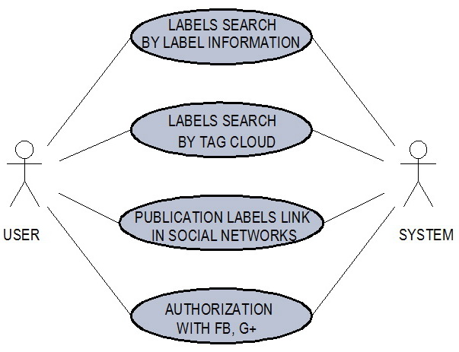
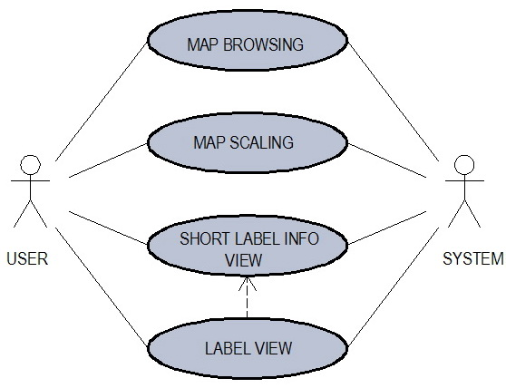
Use case diagramm
User

Slide 5
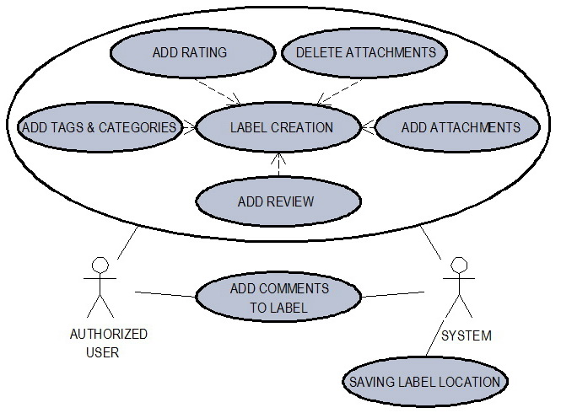
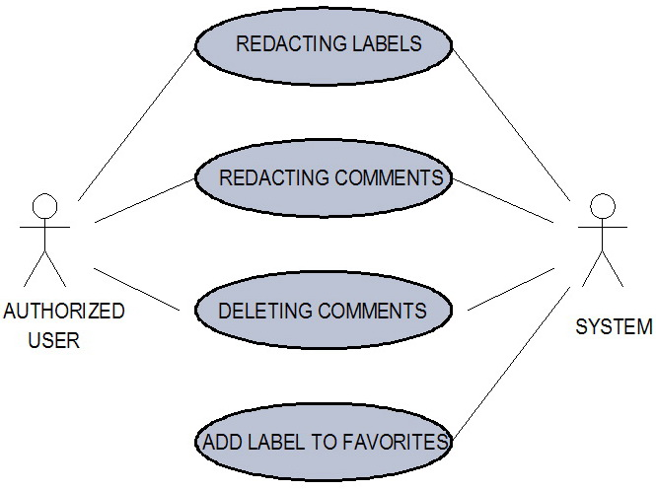
Use case diagramm
Authorized user

Slide 6
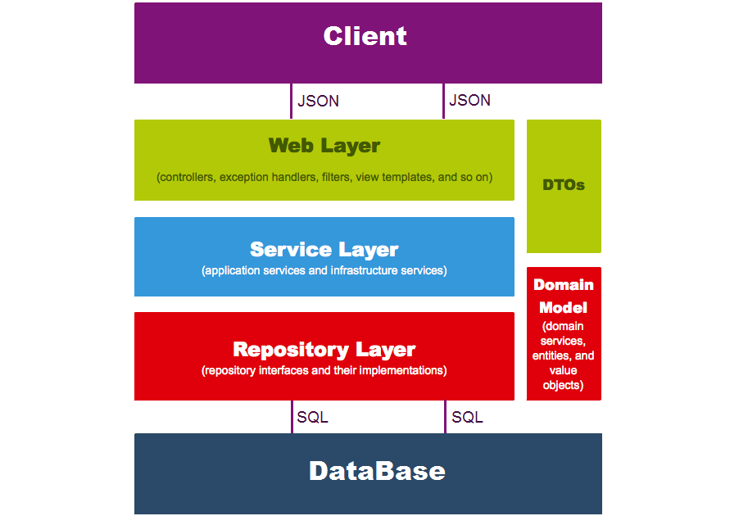
Simple application architecture model

Slide 7
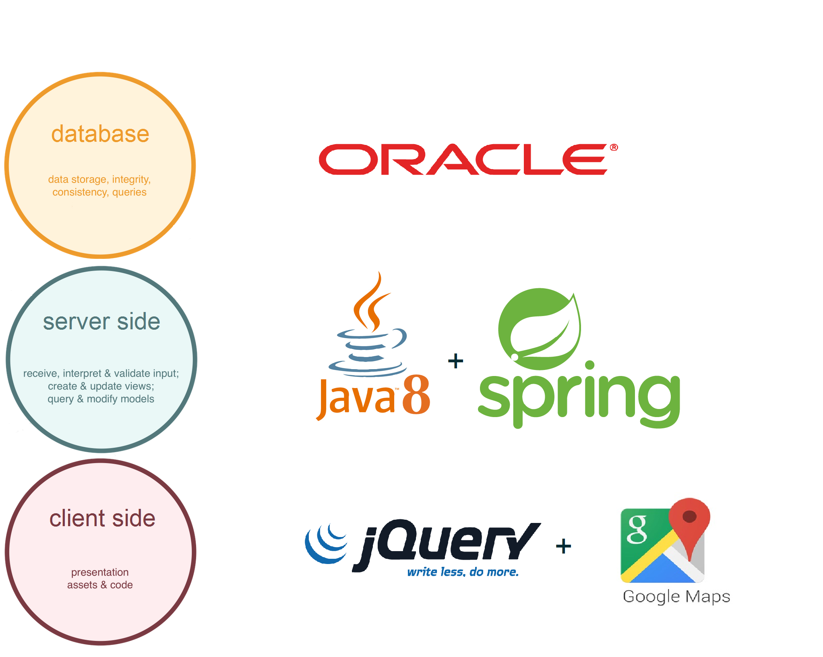
Used technologies

Slide 8
Database overview
Oracle database;
Object model;
Relational model;

Slide 9
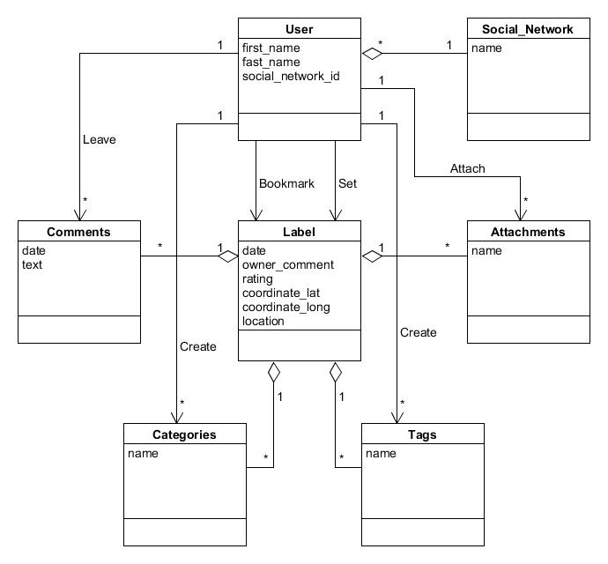
Object model

Slide 10
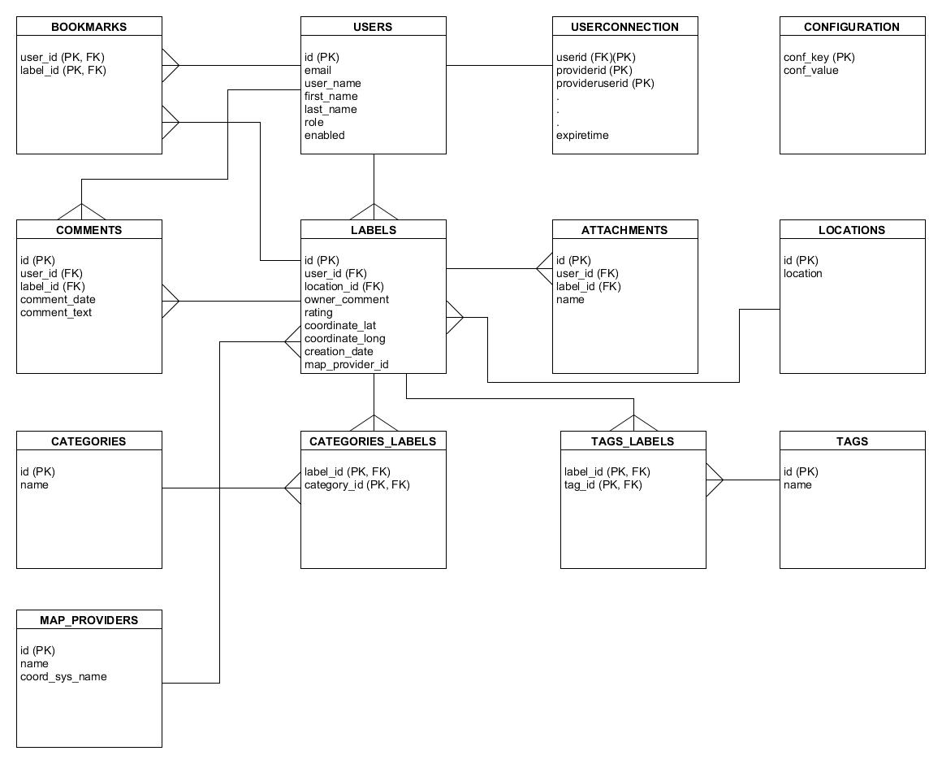
Relational model

Slide 11
Server side overview
Maven modules;
Main functions lifecycles;
Security;
Web Architecture;

Slide 12

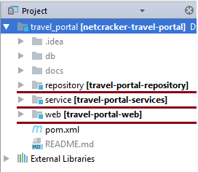
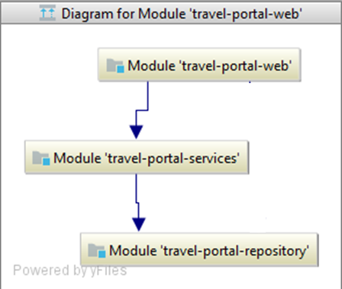
Each Maven module represent its own layer.

Slide 13
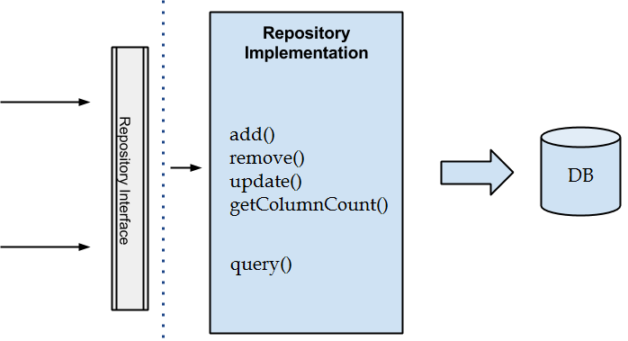

Repository layer
Repository pattern for CRUD.
Specification classes for complicated queries.

Slide 14

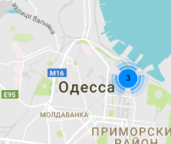
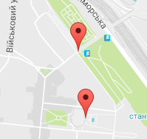

Service layer
View labels on map lifecycle.
JSON
с координатами
Приблизить
MapController
JSON
метки
Список меток
Координаты
LabelService
Метки в полигоне
Label
Repository
getByRect()
Вычисление полигона
Поиск меток в полигоне
Запрос на метки

Slide 15
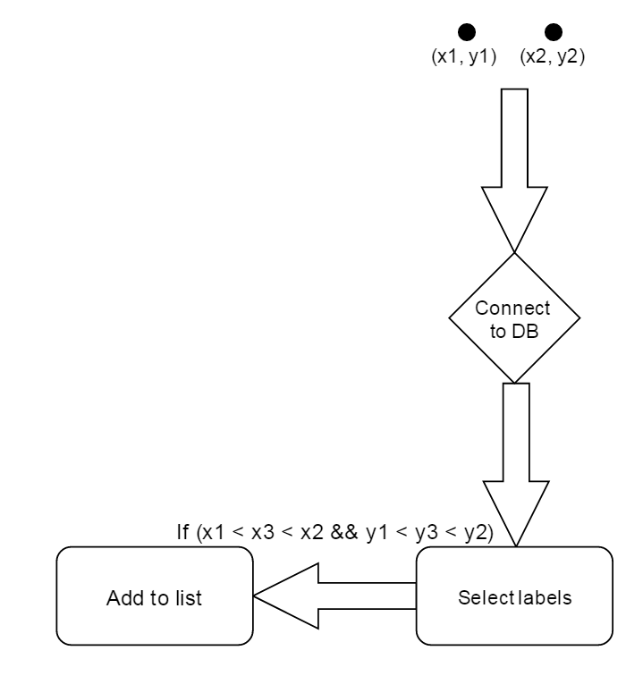
Service layer
View labels on map lifecycle.
1. Calculation rectangle by 2 points
2. Query for labels inside rectangle
В(x2, y2)
А(x1, y1)
Label P (x3, y3)
3. Convert entities to DTO.

Slide 16
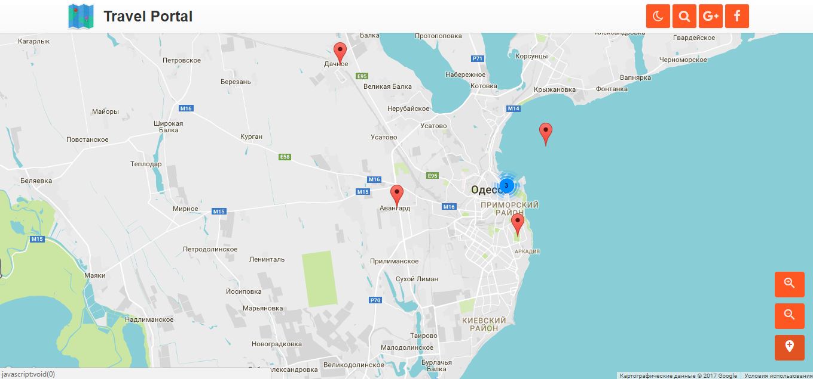
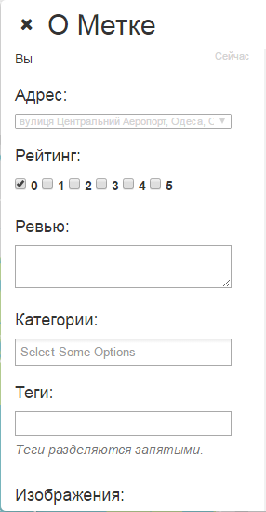
Service layer
Add label lifecycle.

Slide 17
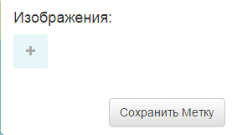
Service layer
Add label lifecycle.
LabelController
JSON with new
Label information
JSON with full
Label information
Label
userId
Label
Repository
Label
Location
Repository
LabelService
new Label
add()
Tag
Repository
add
Category
Repository

Slide 18
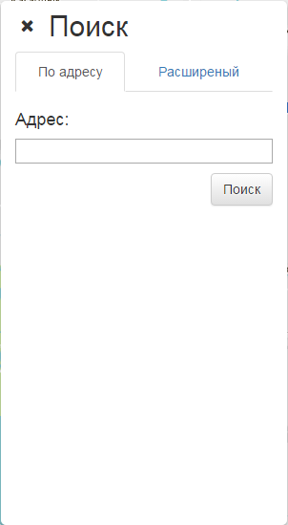
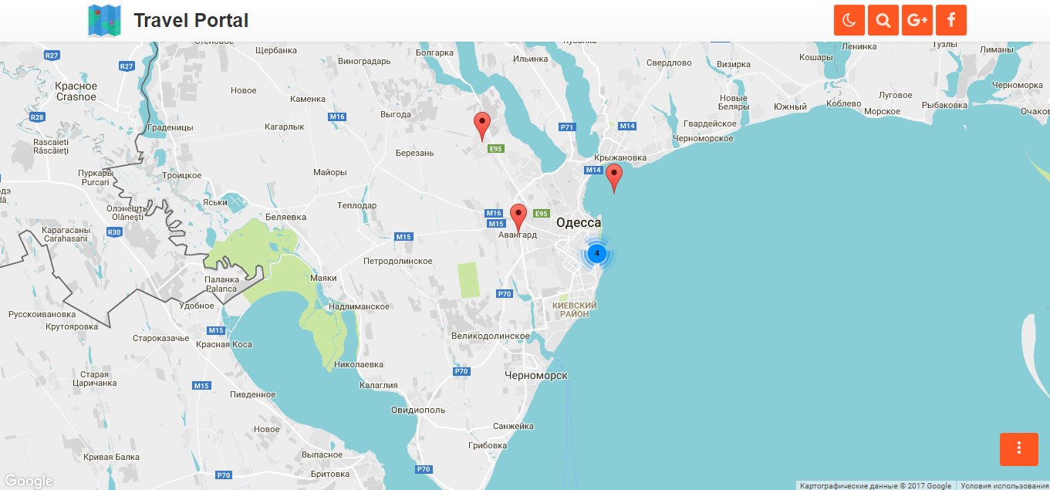
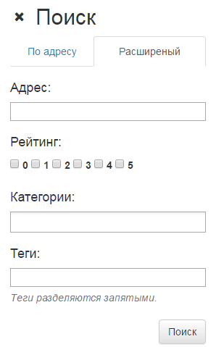
Service layer
Find/filtrate labels.

Slide 19
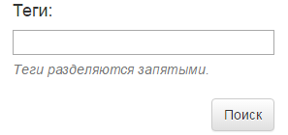
Service layer
Find/filtrate labels.
Label Controller
Label Repository
Label Service
getLabelsByTag()

Slide 20
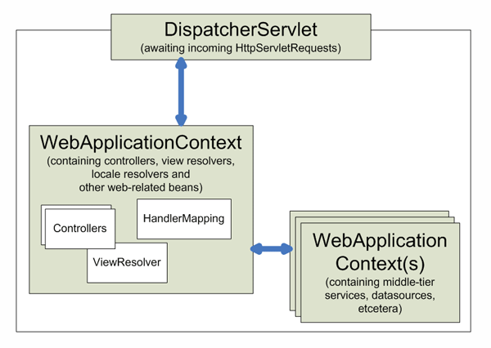
Web layer
Spring MVC

Slide 21
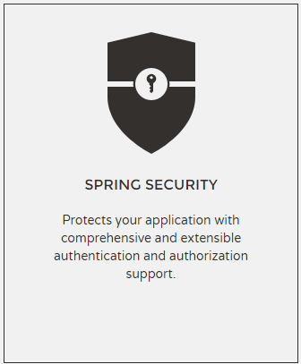
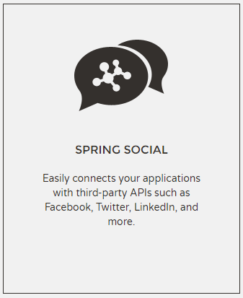

Authorization

Slide 22


Web layer
User
Anonimus
Authorized user
Map browsing
Search labels;
View labels;
Publish labels in sicial networks
Anonimus abilities;
Creating label;
Adding attachments;
Adding comments;

Slide 23
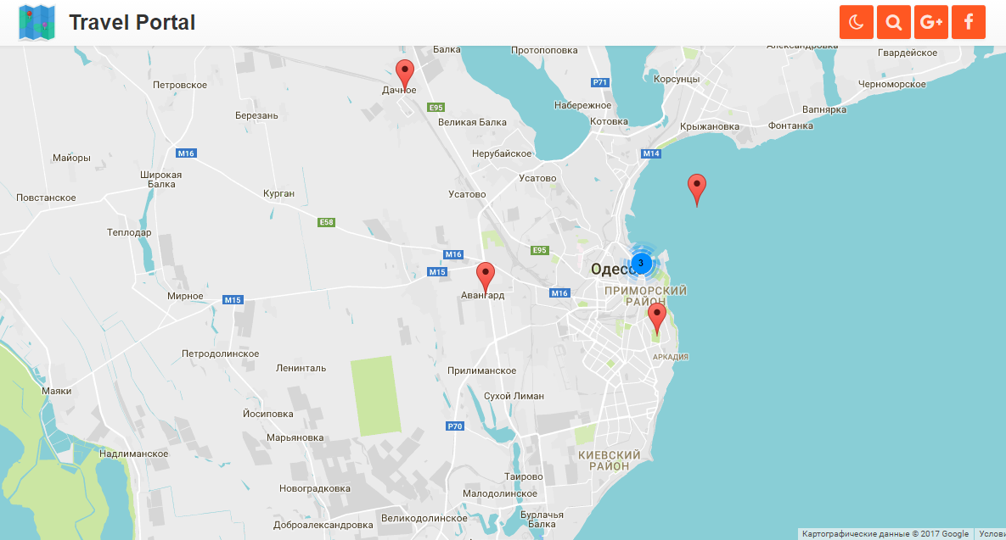
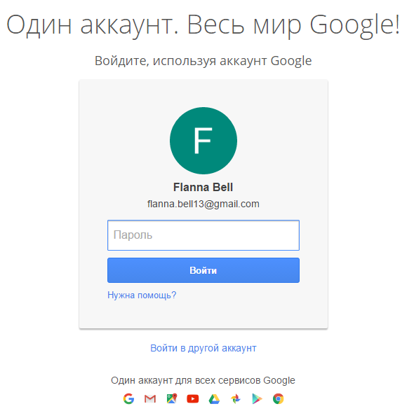
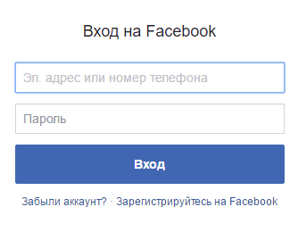
Web layer
Authorization via social networks.

Slide 24
Web layer
Security and aunthentication

Slide 25
Client side overview
Architecture
Used Technologies
Why we chose a particular technology
UI Overview

Slide 26
Architecture
Event Listeners (Hooks)
Window Drawer
Services
TPL
Third Party Libraries
Map Controller
Window Controller
Views
Google Maps API (+Geocoding)
SERVER

Slide 27
Used Technologies / Modules
TypeScript - programming language that extends JS
Require.JS - async JS dependency injector
jQuery - frontend JS framework
Bootstrap - CSS styling framework
MMenu (jQuery Module) - mobile style navigation
Toast (jQuery Module) - information popups
Validate (jQuery Module) - form validation
FeatherLight (jQuery Module) - image gallery

Slide 28


Why TypeScript
and what is Require.JS?
TypeScript - programming language that brings you optional static type-checking along with the latest ECMAScript features.
Require.JS - async JS dependency injector that loads modules by importing scripts using special code in the top of the module. It is very usefull when TypeScript is compiles with “--module AMD” parameter.

Slide 29
Why Bootstrap?
Easy to get started
Great grid system
Base styling for most HTML elements
Extensive list of components
Bundled Javascript plugins
Good documentation

Slide 30
Why jQuery?
Open Source
Endless Tutorials
Huge Library
Cross-platform

